Slide 1
Trusted Traffic data sharing with Congestion control in Internet of Vehicles using Blockchain
By
Mageshboopathy V -422420104019
Santhosh A -422420104030
Praveen P -422420104306
Guided by
Mr.R.Manikandan M.E.,(Ph.D)
Teaching Faculty,
Department of Computer Science and Engineering
University college of Engineering Tindivanam

Slide 2
BASE PAPER DETAILS
Title : Trusted Traffic data sharing with Congestion control using
Blockchain in Internet of Vehicles
Name of the Publisher : IEEE
Name of the Transaction : Intelligent Transportation System
Year and Month of Publication : March 2023
Volume No. : 24
Issue No. : 3
Page No. : 3489 - 3500

Slide 3
DOMAIN DESCRIPTION
Domain Name: Blockchain
Blockchain is a decentralized and distributed digital ledger technology that is used to record transactions across multiple computers in a secure and transparent manner.
A blockchain consists of a chain of blocks, each containing a set of transactions. These blocks are linked together in a chronological order, forming a continuous and immutable record of transactions.
Blockchain technology has the potential to revolutionize how data and transactions are recorded and verified, offering increased security, transparency, and efficiency in various domains.

Slide 4
INTRODUCTION
According to WHO estimates, road traffic accidents kill 1.35 million people worldwide every year and are currently leading cause of mortality among children.
The advent of the Internet of Vehicles (IoV) has ushered in a new era of intelligent transportation systems, revolutionizing the way vehicles communicate and share data on the road.
In the IoV ecosystem, vehicles, infrastructure, and various sensors collaborate to provide real-time information that has the potential to enhance road safety, reduce traffic congestion, and pave the way for more efficient and sustainable transportation.
However, as this interconnected web of vehicles and data sources grows, ensuring the trust, security, and integrity of the information exchanged becomes an increasingly complex challenge.

Slide 5
-
This model leverages blockchain technology to create a decentralized and tamper-resistant ledger for the IoV, offering a solution to the inherent vulnerabilities associated with data transmission in a highly dynamic and potentially adversarial environment. Our system integrates congestion control mechanisms to optimize data sharing, mitigating traffic bottlenecks, and facilitating efficient and reliable communication among vehicles.
It is our aim to provide a foundation for secure, efficient, and trusted data sharing within the IoV ecosystem, thereby enhancing the safety, convenience, and sustainability of future mobility systems.

Slide 6
ABSTRACT
In Internet of Vehicles, the centralized trust management systems are proposed. They work efficiently but have issues with single point of failure and being tampered.
While in decentralized trust management systems, communication overhead occurs during trust evaluation process.
To overcome this issues, a blockchain based trusted data sharing mechanism with congestion control is proposed. There are two phases, data sharing and trust evaluation phase. The mechanism contains two steps.
First, Kademlia algorithm-based traffic data forwarding method which is used to control the channel congestion.

Slide 7
-
Second, Cuckoo filter-based traffic data deduplication to avoid repetitive sharing of same data by checking local filters in vehicles and RSUs.
Here RSUs act as full nodes and vehicles are light nodes in the blockchain.
The trust evaluation is done from the vehicles. Atlast, we develop a trust management prototype system with congestion control which is much effective.

Slide 8
LITERATURE SURVEY
S.NO | TITLE | AUTHOR & YEAR OF PUBLICATION | TECHNIQUE USED | MERITS | DE-MERITS
1 | A blockchain-based roadside unit-assisted authentication and key agreement protocol for Internet of Vehicles. | Z. Xu, W. Liang & 2021 | Internet of Vehicles | Trust and Transparency, Security, Decentralization, Smart Contracts | Scalability, Latency, Energy consumption, Interoperability, Governance and Compliance
2 | Multitype highway mobility analytics for efficient learning model design: A case of station traffic prediction | S. Duan et al & 2022 | VANET | Improved Traffic Prediction, Enhanced Traffic Management, Better Resource Allocation, Safety Improvements. | Data Complexity, Data Integration, Model Complexity, Data Privacy and Ethics, Data Volume.

Slide 9
S.NO | TITLE | AUTHOR & YEAR OF PUBLICATION | TECHNIQUE USED | MERITS | DE-MERITS
3 | A blockchain-based solution for reputation management in IoV. | S. Abbes and S. Rekhis & 2021 | Blockchain in IoV | Security and Immutability, Transparency and Trust, Decentralization, Privacy Control. | Scalability, Energy Consumption, Complexity, Adoption Challenges, Data Privacy and Regulation.
4 | LVBS: Lightweight vehicular blockchain for secure data sharing in disaster rescue. | Z. Su, Y. Wang, Q. Xu, and N. Zhang & 2022 | Blockchain Technology | Decentralization, Real-time Updates, Trust and Transparency, Data Integrity, User Control. | Energy Consumption, Implementation Complexity, Adoption Challenges, Infrastructure Dependency.

Slide 10
S.NO | TITLE | AUTHOR & YEAR OF PUBLICATION | TECHNIQUE USED | MERITS | DE-MERITS
5 | Blockchain based trustworthy energy dispatching approach for high renewable energy penetrated power systems | Y. Xu, Z. Liu, C. Zhang, J. Ren, Y. Zhang, and X. Shen & 2022 | Blockchain | Enhanced Transparency, Security, Decentralization, Reduced Counterparty Risk, Integration of Renewables. | Scalability, Energy Consumption, Complexity, Interoperability, Regulatory Challenges.
6 | Blockchain based decentralized trust management in vehicular networks | Z. Yang, K. Yang, L. Lei, K. Zheng, and V. C. M. Leung & 2019 | Trust Management in Blockchain | Data Transparency, Resilience to Single Points of Failure, Privacy Control, Secure Vehicle-to-Vehicle Communication. | Energy Consumption, Complexity, Adoption Challenges, Regulatory Concerns, Data Privacy.

Slide 11
PROBLEM STATEMENT
In Internet of Vehicles, the data shared by the vehicles are not always trustable due to presence of attackers. So, trust management was introduced in IoV.
In existing literatures, centralized trust management systems are proposed. They have issues with single point of failure and being tampered.
Communication overhead occurs between nodes during trust evaluation process.

Slide 12
OBJECTIVES
To introduce decentralized trust management system in vehicular network using blockchain.
To reduce congestion in data transfer using Kademlia algorithm and cuckoo filter.

Slide 13
SCOPE
Trustworthy data sharing in IoV
Improvement in Traffic efficiency
Accidents avoidance
Prevention of Data Congestion

Slide 14
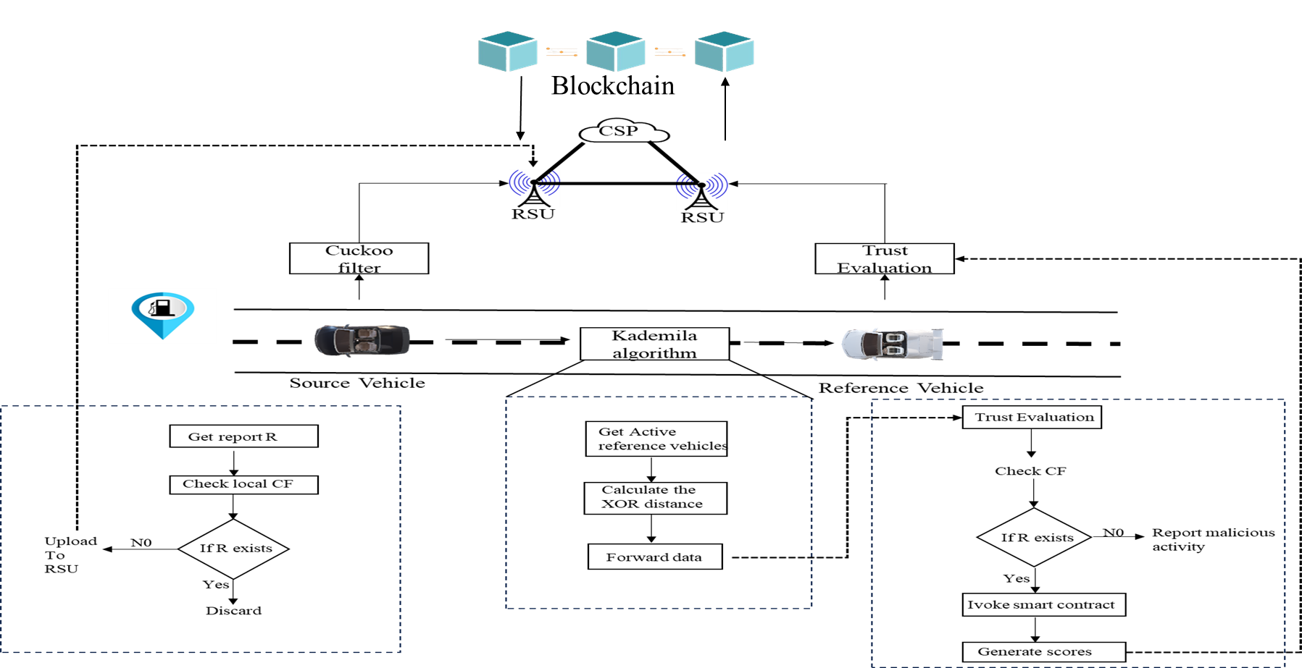
SYSTEM ARCHITECTURE

Slide 15
MODULE DESCRIPTION
Trust Evaluation Phase
Data Sharing Phase
Congestion control
Security analysis
Trust Management:
To make vehicles behave honestly and reduce communications overheads, we propose unique trust management mechanism. RSUs will initiate the trust evaluation process.
Vehicles are divided into source vehicles and reference vehicles. Source vehicles transmit the report set to other vehicles, then the reference give the score to update the trust values.

Slide 16
Data Sharing Phase:
Our scheme depends on the close cooperation between the vehicles, RSUs and CSP. Vehicles are equipped with multiple sensor like cameras, wave radar, etc.
The data sharing phase is completed using Kademlia algorithm. It uses the XOR algorithm to calculate the distance between the nodes and resources. By using this distance, the report is forwarded to nodes.
Congestion Control:
Congestion control mechanism is implemented by using Cuckoo filter method. It is a data structure algorithm used to find whether a data is present in a set or not.
The vehicles and RSUs consist of the local filters and vehicles check whether the data is already shared or not. The RSUs check the repetitive times of a report

Slide 17
Security Analysis:
To maintain the defence against the vehicle misbehaviour such as lazy sharing, message spoofing, message inconsistency, giving unfair score and collusion attack we should look into the security of the data sharing phase.
On the other hand, we should look into defence against RSU failure. It can be divided into two types such as individual failure and regional failure.

Slide 18
ALGORITHM 1:
Input: Traffic report set Ri, Trust values Ti
Output: Cuckoo filter CFk
1: for r∈Ri, i ∈ {1, 2…, n} do
2: f=fingerprint(r)
3: i1=hash(r), i2=i1⊕hash(f)
4: if local filter CF′k contains r then
5: update repeat times tr in CF′k
6: continue
7: else
8: Add <H(r) || 1> to CF′k
9: Send Reqi=EpkRSUj(r||VINi) to RSUj
10: end if
11: RSUj decrypts Reqi to get r
12: if CFk contains f then
13: update <H(r) || tr> to <H(r)||tr+1>
14: else if bucket[i1] or bucket[i2] has empty entry then
15: select a entry to insert <H(r) || 1>
16: else
17: return Failure
18: end if
19: end for
20: return CFk

Slide 19
DEDUPLICATED TRAFFIC REPORTS UPLOADING:
Iterate over each traffic report r in the set Ri. Generate a fingerprint f for the traffic report.
Compute two hash values i1 and i2 based on the traffic report.
Check if the local filter CFk contains the traffic report r. If it does, update the repeat times in CFk and continue. If it doesn't, add the fingerprint and a counter to CFk and send a request to a Road Side Unit (RSU).
RSU decrypts the request to get the traffic report. If the cuckoo filter CFk contains the fingerprint f, update the corresponding entry.
If the buckets associated with the hash values have empty entries, insert the fingerprint. If none of the above conditions are met, return failure.
Repeat this process for each traffic report in the set Ri. Return the final cuckoo filter CFk.

Slide 20
ALGORITHM 2:
Input: Vehicle coordinate λj
Output: Traffic report set Ri
1:for vj, j ∈ {1, 2…, m} do
2: d (i, j) =λi⊕λj
3: if d (i, j) ≥d then
4: vi discard vj in RTi and continue
5: end if
6: find index x satisfying d (i, j) ∈[2x,2x+1)
7: if k -bucket[x] is not full then
8: insert vj to k -bucket[x]
9: else
10: remove invalid node in k -bucket[x]
11: insert vj to k -bucket[x]
12: end if
13: vi transmits Ri to vj in RTi
14: end for
15: return Ri

Slide 21
TRAFFIC REPORTS FORWARDING:
Iterate over each vehicle vj in a set {1, 2, ..., m}. Calculate the distance between the vehicles using an XOR operation on their coordinates.
If the calculated distance is greater than or equal to a threshold d, discard the current vehicle vj from the traffic report set RTi associated with the reference vehicle vi, and continue to the next vehicle.
Find an index x that satisfies a specific range condition based on the distance d (i, j).
If the k-bucket at index x is full, remove an invalid node from it and then insert the current vehicle vj.
Transmit the traffic report set Ri. Repeat this process for all vehicles in the set.

Slide 22
ALGORITHM 3:
Input: Report set Ri and Rj, Original trust value Ti
Output: Trust value T′i
1: for vj, j ∈ {1,2…m} do
2: Φ (Ri, Rj) =Ri∩Rj
3: for report r ∈Φ (Ri, Rj) do
4: if H(r) is not contained in CFk then
5: update trust value T′i=Ti⋅(1−ε) μ
6: else if vj thinks r is correct then
7: update N(c)=N(c)+1
8: else
9: update N (c¯) = N (c¯) +1
10: end if
11: end for
12: calculate Sj→i=N(c)/(N(c)+N (c¯))
13: end for
14: get average score Si=∑mj=1Tj⋅Sj→i/m
15: if Si≥Ti then
16: update trust value T′i=Ti+(Si−Ti) ρ
17: else
18: update trust value T′i=Ti−(Ti−Si) σ
19: end if
20: return T′i

Slide 23
TRUST EVALUATION:
Iterate over each vehicle vj in a set {1, 2, ..., m}. Calculate the intersection of the report sets Ri and Rj.
For each report r in the intersection of Ri and Rj:
If the hash of the report r is not contained in the cuckoo filter CFk, update the trust value T'i of vehicle vi based on some formula. Otherwise, if vehicle vj thinks the report r is correct, update a counter N(c) representing correct reports; otherwise, update N(c¯) representing incorrect reports.
Calculate the score Sj→i representing the trust score from vj to vi. Get the average score Si based on scores from all vehicles vj.
If the average score Si is greater than or equal to the original trust value Ti, update the trust value T'i of vi with a positive adjustment factor ρ.
If Si is less than Ti, update T'i with a negative adjustment factor σ. Return the updated trust value T’i.

Slide 24
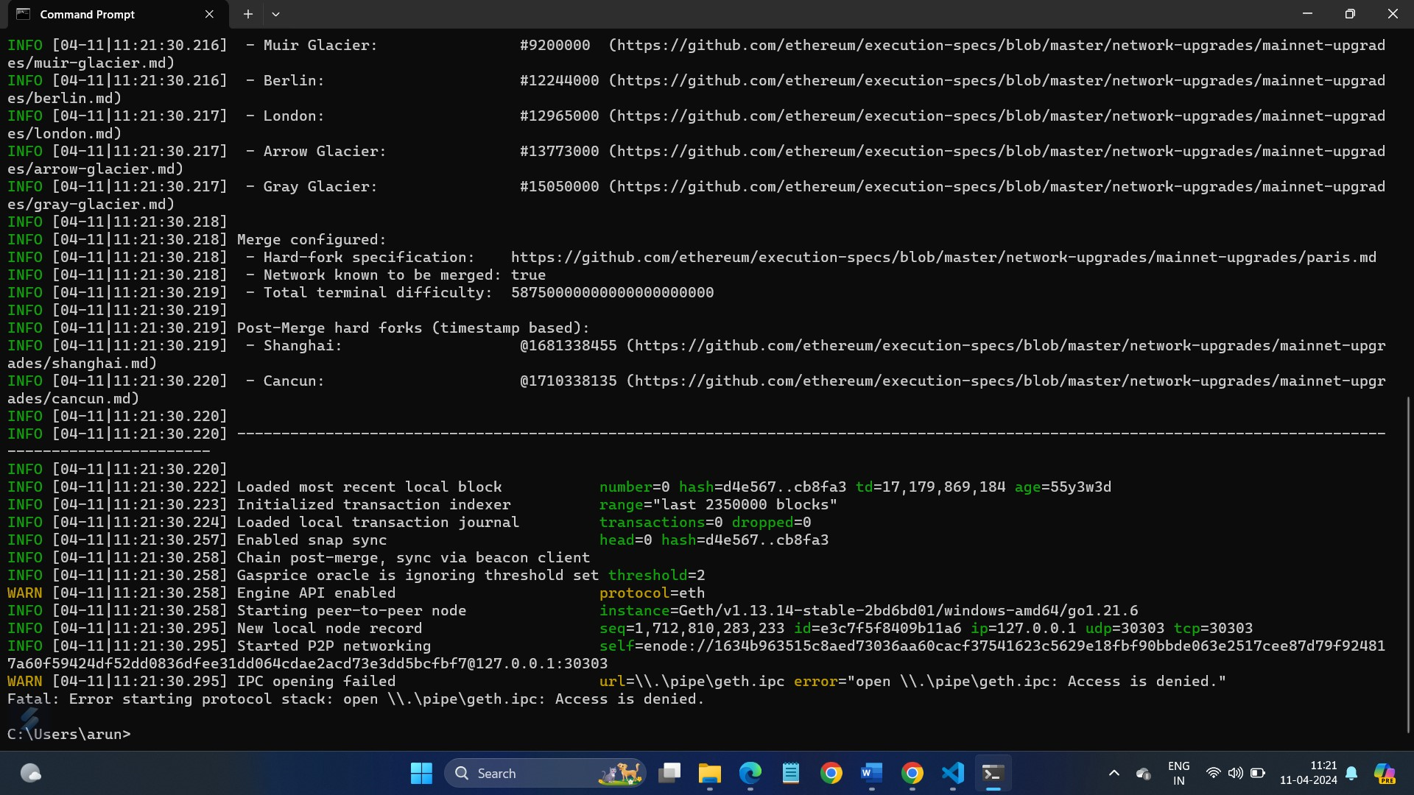
IMPLEMENTATION AND RESULTS
BLOCKCHAIN CREATION

Slide 25
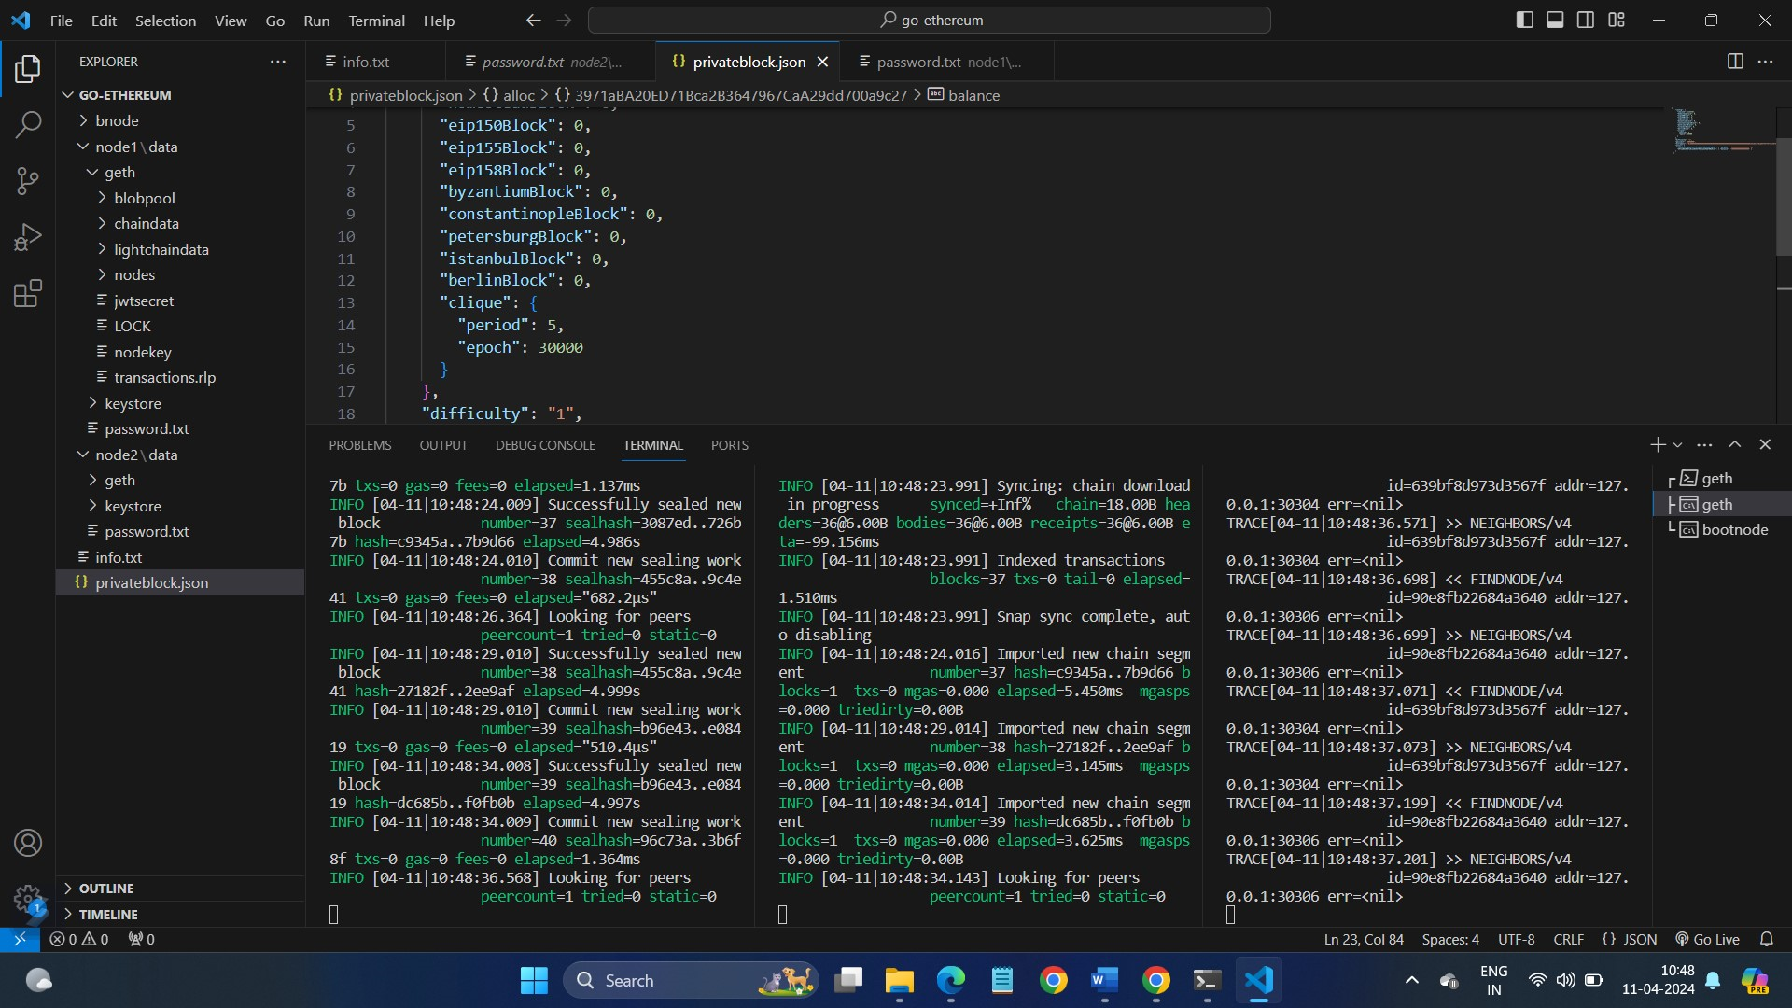
PRIVATE ETHEREUM BLOCKCHAIN

Slide 26
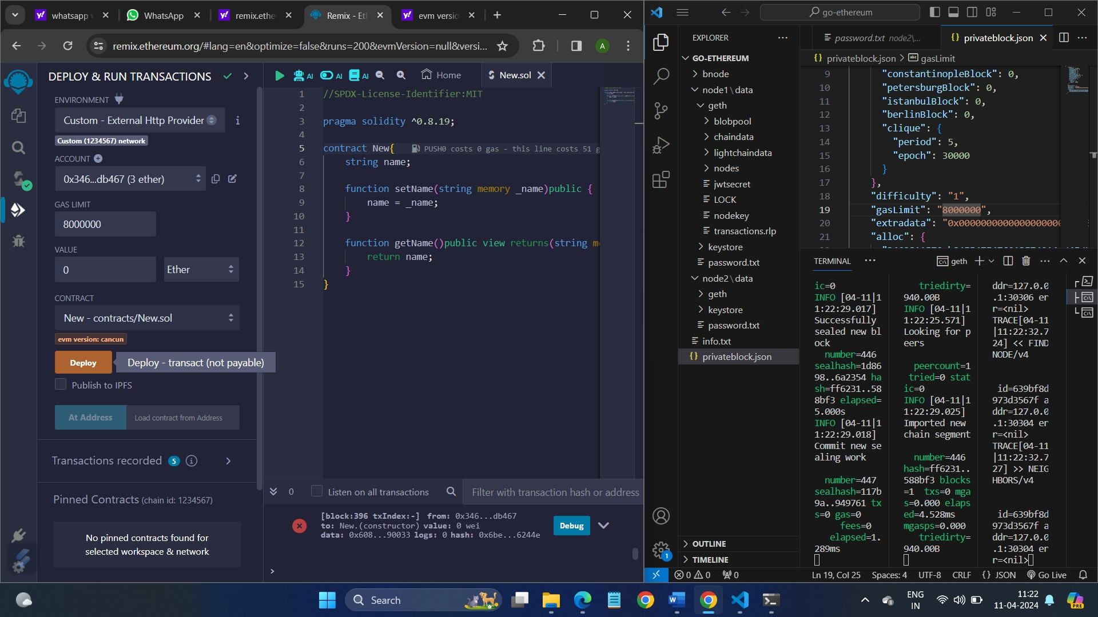
DEPLOYING BLOCKCHAIN

Slide 27
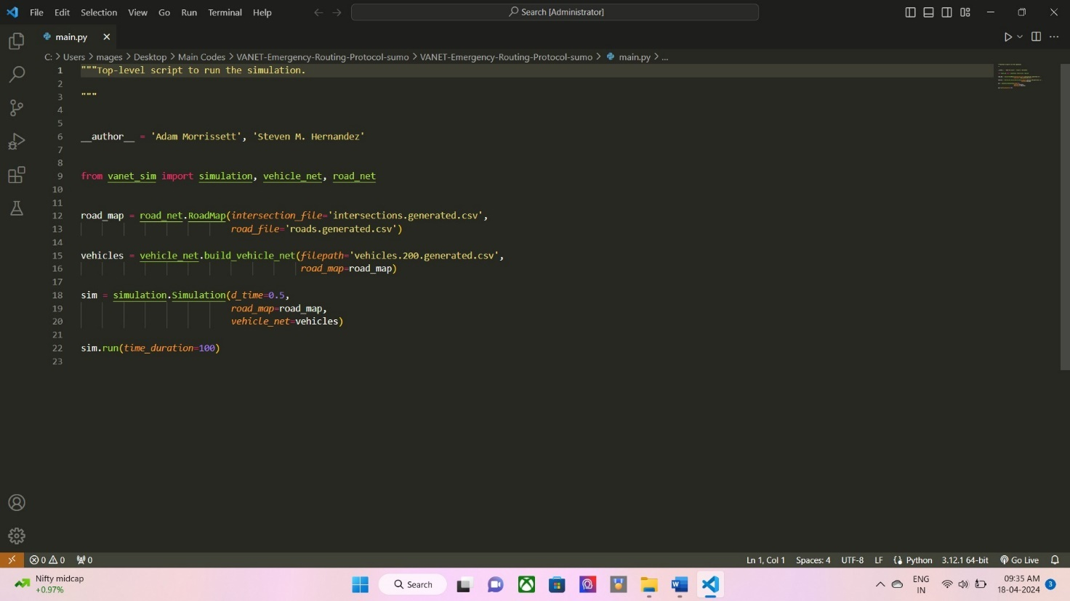
VANET SIMULATION

Slide 28
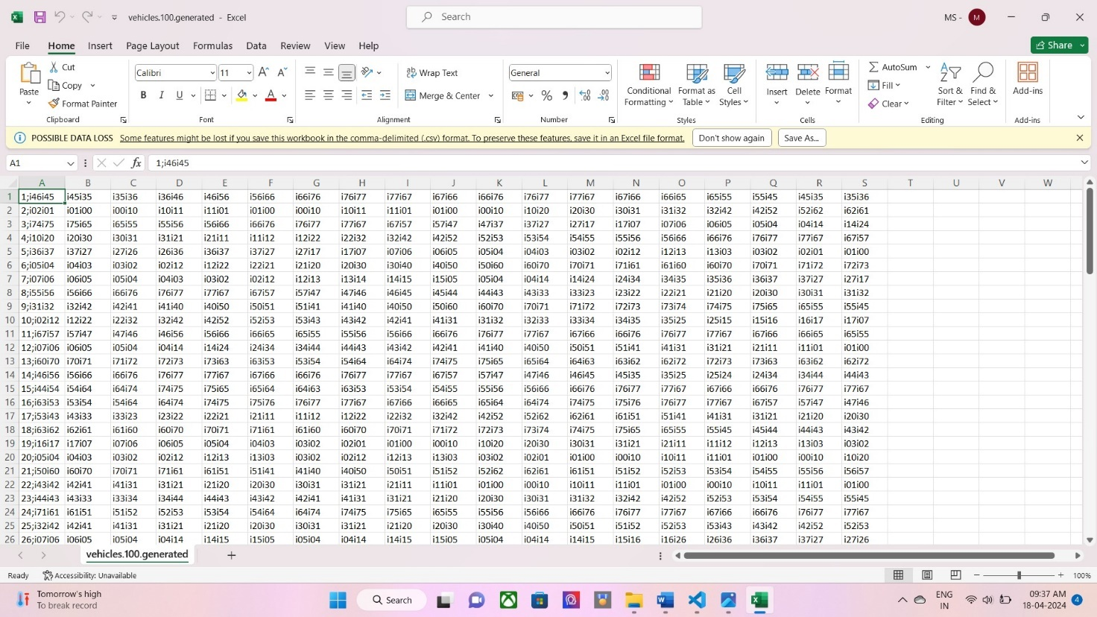
VEHICLES DATA

Slide 29
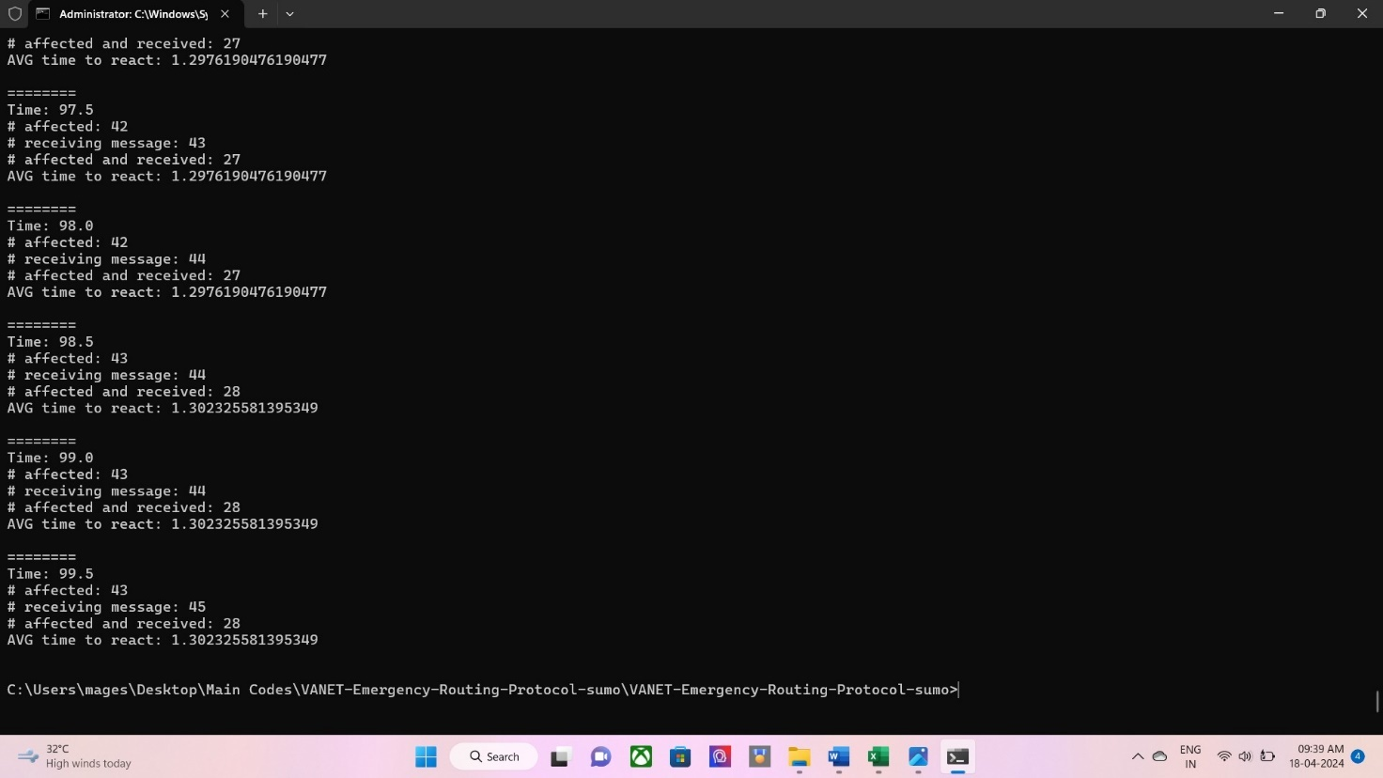
VEHICULAR CONNECTION

Slide 30
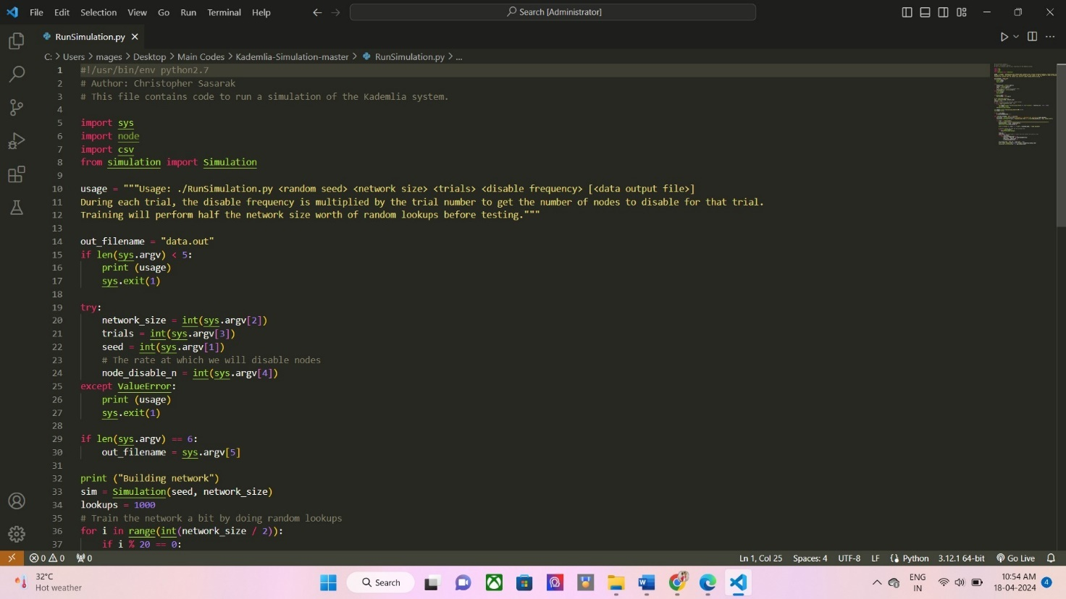
KADEMLIA ALGORITHM

Slide 31
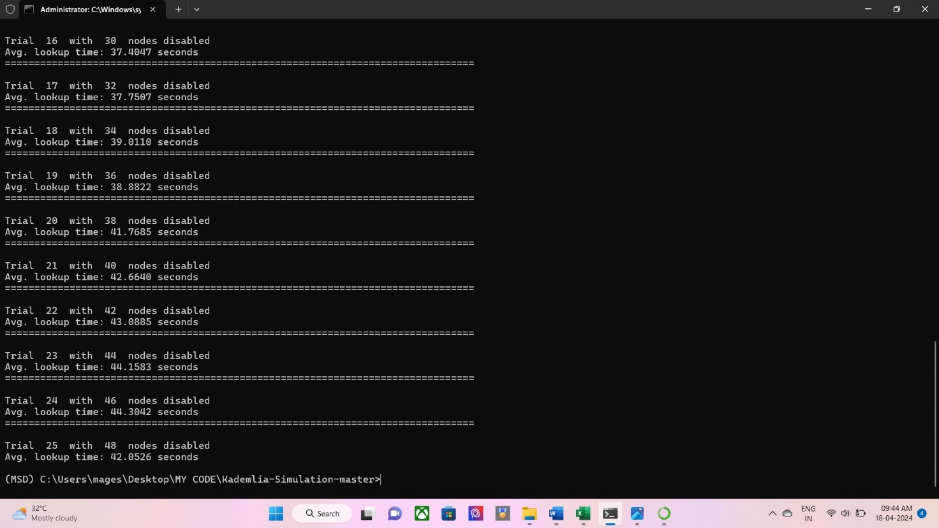
DATA FORWARDING

Slide 32
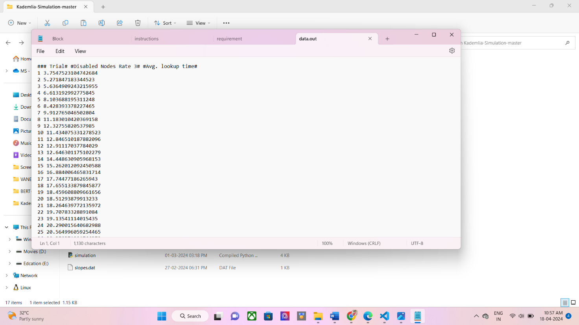
OUTPUT

Slide 33
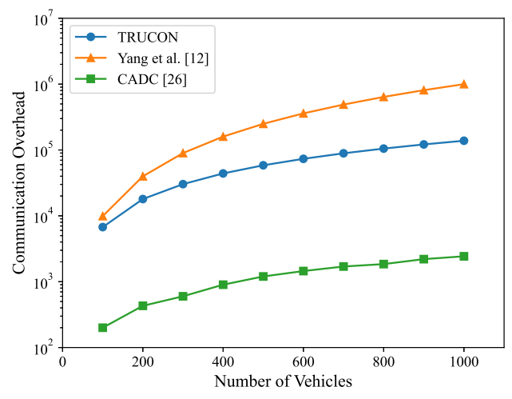
PERFORMANCE ANALYSIS
COMMUNICATION OVERHEAD COMPARISON
The comparison is done between the following existing literatures.
1) Yang et al
2) CADC
Results clearly shows that our system is better than Yang et al. Where in CADC the congestion control is good but it has no trust evaluation. Thus our system is feasible and effective.

Slide 34
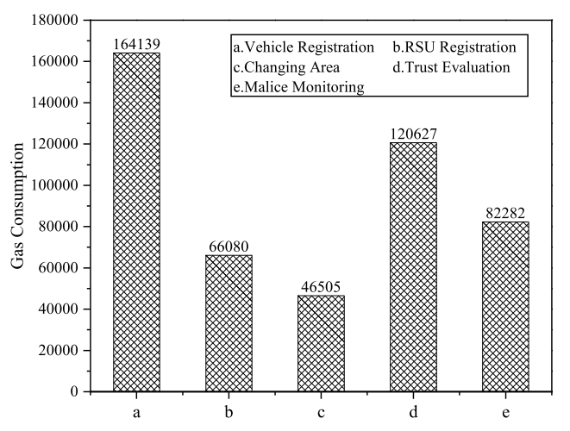
GAS CONSUMPTION
The Ethereum blockchain consists of the 3 ether with 3 lakh units. The gas consumption value for the each process is compared used the graph.
In these, vehicle registration consumes the most units of gas.

Slide 35
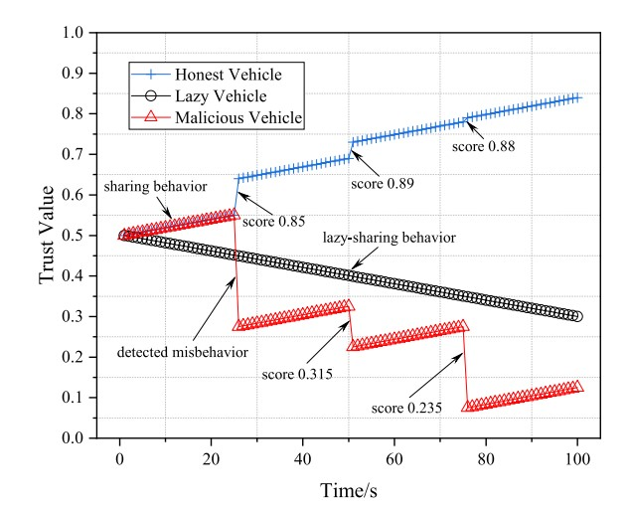
TRUST VALUE EVALUATION
Types of vehicles
1) Honest vehicle [value increases]
2) Lazy vehicle [value decreases]
3) Malicious vehicle[uneven at intervals]

Slide 36
CONCLUSION AND FUTURE WORK
CONCLUSION
To ensure the safety of the traffic and the accidents avoidance, a blockchain based trusted data sharing mechanism with congestion control is built to solve the trust problems existing in IoV.
The system initialization phase consists of the deploying blockchain. Next for the congestion control mechanism we use the Kademlia data forwarding algorithm to share data and Cuckoo filter to share deduplicated data to RSU.
Atlast the trust value calculation is done by the vehicles and RSU. Our system works efficiently while comparing the existing literatures because we consist both the trust management and the congestion control mechanism.

Slide 37
FUTURE WORK
The shortcoming of our current work is that applicable scenarios are limited and we did not take privacy issues into consideration.
The effect of congestion control is limited when there are few vehicles. In the future, we will keep trying to reduce the communication overhead.
Besides, we will also work to protect the security of private information of vehicles such as their real identity and location.

Slide 38
REFERENCES
Z. Xu, W. Liang, K.-C. Li, J. Xu, and H. Jin - A blockchain-based roadside unit-assisted authentication and key agreement protocol for Internet of Vehicles - J. Parallel Distributed Computing, vol. 149, pp. 29–39, Mar. 2021.
S. Duan et al., - Multitype highway mobility analytics for efficient learning model design: A case of station traffic prediction - IEEE Transaction on Intelligent Transportation System., vol. 23, no. 10, pp. 19484–19496, Oct. 2022.
S. Abbes and S. Rekhis - A blockchain-based solution for reputation management in IoV - International Wireless Communication Mobile Computing (IWCMC), Jun. 2021, pp. 1129–1134.
Z. Su, Y. Wang, Q. Xu, and N. Zhang - LVBS: Lightweight vehicular blockchain for secure data sharing in disaster rescue - IEEE Transaction on Dependable Secure Computing, vol. 19, no. 1, pp. 19–32, Jan. 2022.

Slide 39
Y. Xu, Z. Liu, C. Zhang, J. Ren, Y. Zhang, and X. Shen - Blockchain based trustworthy energy dispatching approach for high renewable energy penetrated power systems - IEEE Internet Things J., vol. 9, no. 12, pp. 10036–10047, Jun. 2022.
Z. Yang, K. Yang, L. Lei, K. Zheng, and V. C. M. Leung – Blockchain based decentralized trust management in vehicular networks – IEEE Transaction on Internet Things J., vol. 6, no. 2, pp. 1495–1505, Apr. 2019.

Slide 40

THANK YOU

